Slide 1
Women’s University
Ai Miyagi
Dept. of
Modern Business

Slide 2
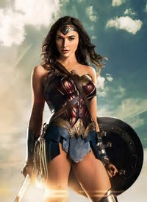
A place
to become
a strong woman

Slide 3
Why I chose
a women’s university

Slide 4
An environment
where each woman
is active

Slide 5
How to study business
in my university

Slide 6
Business classes

Slide 7
5 business
English classes

Slide 8
Presentation class
in English

Slide 9
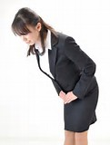
Thank you

